Slide 1
Database
Functional Dependency,
Schema Refinement
& Normal Forms

Slide 2
Outline
Problems caused by redundancy
Functional dependencies
Boyce Codd normal form (BCNF)
Third normal form (3NF)
Decomposition
Dependency preservation
BCNF decomposition algorithm
3NF decomposition algorithm
Design Goal

Slide 3
1. Problems caused by redundancy
Waste of resources of storage
Potential inconsistency

Slide 4
1. Problems caused by redundancy
Student-ID | Student-Name | Course-ID | Course-Name
123 | Raymond | COMP231 | Database
123 | Raymond | COMP170 | D. Math
567 | Mary | COMP104 | C++
567 | Mary | COMP271 | Algorithm
999 | Peter | COMP231 | Database
Redundancy!
Waste of resources

Slide 5
1. Problems caused by redundancy
Student-ID | Student-Name | Course-ID | Course-Name
123 | Raymond | COMP231 | Database
123 | Raymond Wong | COMP170 | D. Math
567 | Mary | COMP104 | C++
567 | Mary | COMP271 | Algorithm
999 | Peter | COMP231 | Database
Inconsistency!

Slide 6
1. Problems caused by redundancy
Decomposition
The essential idea is that many problems arising from redundancy can be addressed by replacing a relation with a collection of “smaller” relations

Slide 7
1. Problems caused by redundancy
Student-ID | Student-Name | Course-ID | Course-Name
123 | Raymond | COMP231 | Database
123 | Raymond | COMP170 | D. Math
567 | Mary | COMP104 | C++
567 | Mary | COMP271 | Algorithm
999 | Peter | COMP231 | Database
Student-ID | Course-ID
123 | COMP231
123 | COMP170
567 | COMP104
567 | COMP271
999 | COMP231
Course-ID | Course-Name
COMP231 | Database
COMP170 | D. Math
COMP104 | C++
COMP271 | Algorithm
Student-ID | Student-Name
123 | Raymond
567 | Mary
999 | Peter
No potential inconsistency

Slide 8
Outline
Problems caused by redundancy
Functional dependencies
Boyce Codd normal form (BCNF)
Third normal form (3NF)
Decomposition
Dependency preservation
BCNF decomposition algorithm
3NF decomposition algorithm
Design Goal

Slide 9
2. Functional dependencies
Functional dependency is a type of constraint that is a generalization of the notation of key
Definition
R – a relation schema, α ⊂ R, β ⊂ R
α → β if and only if,
for any instance r on R,
for any two tuples t₁, t₂ of r
Π_{α}(t₁) = Π_{α}(t₂) ⇒ Π_{β}(t₁) = Π_{β}(t₂)

Slide 10
Example
Can you find a functional dependency that satisfy the following relation?
 | A | B | C | D
1 | a₁ | b₁ | c₁ | d₁
2 | a₁ | b₂ | c₁ | d₂
3 | a₂ | b₂ | c₂ | d₂
4 | a₂ | b₂ | c₂ | d₃
5 | a₃ | b₃ | c₂ | d₄

Slide 11
A → C is satisfied
 | A | B | C | D
1 | a₁ | b₁ | c₁ | d₁
2 | a₁ | b₂ | c₁ | d₂
3 | a₂ | b₂ | c₂ | d₂
4 | a₂ | b₂ | c₂ | d₃
5 | a₃ | b₃ | c₂ | d₄

Slide 12
A → C is satisfied
 | A | B | C | D
1 | a₁ | b₁ | c₁ | d₁
2 | a₁ | b₂ | c₁ | d₂
3 | a₂ | b₂ | c₂ | d₂
4 | a₂ | b₂ | c₂ | d₃
5 | a₃ | b₃ | c₂ | d₄

Slide 13
A → C is satisfied
 | A | B | C | D
1 | a₁ | b₁ | c₁ | d₁
2 | a₁ | b₂ | c₁ | d₂
3 | a₂ | b₂ | c₂ | d₂
4 | a₂ | b₂ | c₂ | d₃
5 | a₃ | b₃ | c₂ | d₄

Slide 14
Is C → A satisfied?
 | A | B | C | D
1 | a₁ | b₁ | c₁ | d₁
2 | a₁ | b₂ | c₁ | d₂
3 | a₂ | b₂ | c₂ | d₂
4 | a₂ | b₂ | c₂ | d₃
5 | a₃ | b₃ | c₂ | d₄

Slide 15
No. There is no such C → A.
 | A | B | C | D
1 | a₁ | b₁ | c₁ | d₁
2 | a₁ | b₂ | c₁ | d₂
3 | a₂ | b₂ | c₂ | d₂
4 | a₂ | b₂ | c₂ | d₃
5 | a₃ | b₃ | c₂ | d₄

Slide 16
Example
Can you find another functional dependency that satisfies the following relation?
 | A | B | C | D
1 | a₁ | b₁ | c₁ | d₁
2 | a₁ | b₂ | c₁ | d₂
3 | a₂ | b₂ | c₂ | d₂
4 | a₂ | b₂ | c₂ | d₃
5 | a₃ | b₃ | c₂ | d₄

Slide 17
Example
D→B is also satisfied.
 | A | B | C | D
1 | a₁ | b₁ | c₁ | d₁
2 | a₁ | b₂ | c₁ | d₂
3 | a₂ | b₂ | c₂ | d₂
4 | a₂ | b₂ | c₂ | d₃
5 | a₃ | b₃ | c₂ | d₄

Slide 18
Example
D→B is also satisfied.
 | A | B | C | D
1 | a₁ | b₁ | c₁ | d₁
2 | a₁ | b₂ | c₁ | d₂
3 | a₂ | b₂ | c₂ | d₂
4 | a₂ | b₂ | c₂ | d₃
5 | a₃ | b₃ | c₂ | d₄

Slide 19
2.1 Trivial and Non-Trivial Functional Dependency
Trivial Functional Dependency
α → β where β ⊆ α
E.g. AB → A
Non-Trivial Functional Dependency
E.g. AB → C

Slide 20
Although A → C is satisfied in this relation instance, can we deduce that A → C is a functional dependency from this result?
 | A | B | C | D
1 | a₁ | b₁ | c₁ | d₁
2 | a₁ | b₂ | c₁ | d₂
3 | a₂ | b₂ | c₂ | d₂
4 | a₂ | b₂ | c₂ | d₃
5 | a₃ | b₃ | c₂ | d₄

Slide 21
Although A → C is satisfied in this relation instance, can we deduce that A → C is a functional dependency from this result?
No.
A→C is satisfied only in this relation instance for this schema.
Functional dependency is defined for all relation instances for a particular schema.
A→C is a functional dependency only if A→C is satisfied for all relation instances for a particular schema.

Slide 22
2.2 Information deduced from Functional dependencies
α is a key for R ⇔ α → R
α is a candidate key for R
α → R, there is no γ s.t. γ ⊂ α, γ → R

Slide 23
Example
A | B | C | D
a₁ | b₂ | c₁ | d₂
a₂ | b₂ | c₁ | d₂
a₁ | b₄ | c₃ | d₃
a₄ | b₄ | c₃ | d₄
AC → R, AD → R, ACD → R

Slide 24
Example
A | B | C | D
a₁ | b₂ | c₁ | d₂
a₂ | b₂ | c₁ | d₂
a₁ | b₄ | c₃ | d₃
a₄ | b₄ | c₃ | d₄
AC → R, AD → R, ACD → R
AC is a candidate key

Slide 25
Example
A | B | C | D
a₁ | b₂ | c₁ | d₂
a₂ | b₂ | c₁ | d₂
a₁ | b₄ | c₃ | d₃
a₄ | b₄ | c₃ | d₄
AC → R, AD → R, ACD → R
AC is a candidate key
AD is also a candidate key

Slide 26
Example
A | B | C | D
a₁ | b₂ | c₁ | d₂
a₂ | b₂ | c₁ | d₂
a₁ | b₄ | c₃ | d₃
a₄ | b₄ | c₃ | d₄
AC → R, AD → R, ACD → R
AC is a candidate key
AD is also a candidate key
but, ACD is not a candidate key

Slide 27
Reasoning about FDs
F : a set of functional dependencies
f: an individual functional dependency
f is implied by F if
whenever all functional dependencies in F are true
then f is true
E.g., F = {A → B, B→C} implies A→C

Slide 28
2.3 Closure of F
F – { f₁, f₂, …, f_{i}, …, f_{n} }
Where f₁, f₂, …, f_{i}, …, f_{n} are functional dependencies
f – an individual functional dependency
F implies f, if whenever all f₁, …, f_{n} are true, f is true
E.g. F = {A →B, B→C}
F implies A→C (by transitivity)
F⁺ – closure of F: the set of all functional dependencies that F implies
E.g. F = {A →B}
F⁺ = {A→A, B→B, AB→AB, A→B, A→AB, AB→A, AB→B}

Slide 29
2.3 Closure of F: Armstrong’s axioms
If β ⊆ α then α → β (reflexivity)
{ A, C } ⊆ { A, B, C } ⇒ ABC → AC
If α → β then γα → γβ (augmentation)
A → B ⇒ CA → CB
If α → β, β → γ then α → γ (transitivity)
A → BD, BD → C ⇒ A → C

Slide 30
2.3 Three Additional Rules
If α → β and α → γ then α → βγ (union)
A → B and A → C ⇒ A → BC
If α → βγ then α → β and α → γ (decomposition)
A → BC ⇒ A→B and A → C
If α → β and γβ → δ then αγ → δ (pseudotransitivity)
A→B and BC→D ⇒ AC→D
The above rules can be inferred from Armstrong’s axioms.
E.g., pseudotransitivity
α → β and γβ → δ (given)
γα → γβ (by augmentation)
γα → δ(by transitivity)

Slide 31
2.4 Closure of attribute sets
α – a set of attributes
α⁺ – closure of α under F
Algorithm to compute α⁺:
result := α
while(changes in result) do
for each β → γ do
if β ⊆ result then result := result ∪ γ
end for
end while

Slide 32
Example
R = (A, B, C, D)
F = { A → B, B → C }
To compute A⁺ :
result = A
result = AB
(A → B)
result = ABC
(B → C)

Slide 33
Outline
Problems caused by redundancy
Functional dependencies
Boyce Codd normal form (BCNF)
Third normal form (3NF)
Decomposition
Dependency preservation
BCNF decomposition algorithm
3NF decomposition algorithm
Design Goal

Slide 34
3. Boyce Codd normal form (BCNF)
R – a relation schema
F – a set of functional dependencies on R
R is in BCNF if for any α → A in F
α → A is trivial (A ∈ α), or
α is a key for R

Slide 35
Example
R is in BCNF if for any α → A in F
α → A is trivial (A ∈ α), or
α is a key for R
R = (A, B, C)
F = { A → B, B → C }
Key = { A }
R is not in BCNF, why?
F = {A → B, B → C}
B is not a key,
{ C } ⊄ { B } (non-trivial)
Decompose R into R₁ = (A, B), R₂ = (B, C), then R₁, R₂ are in BCNF

Slide 36
Outline
Problems caused by redundancy
Functional dependencies
Boyce Codd normal form (BCNF)
Third normal form (3NF)
Decomposition
Dependency preservation
BCNF decomposition algorithm
3NF decomposition algorithm
Design Goal

Slide 37
4. Third normal form (3NF)
R – a relation schema
F – a set of functional dependencies on R
A – a single attribute in R
R is in 3NF if for any α → A in F
α → A is trivial (A ∈ α), or
α is a key for R, or
A is part of some candiate key(s) for R
E.g. AB is a key for R
then A is a part of the key.
B is also a part of the key.
R is in BCNF ⇒ R is in 3NF

Slide 38
Example
R is in 3NF if for any α → A in F
α → A is trivial (A ∈ α), or
α is a key for R, or
A is part of candidate key(s) for R
R = (A, B, C, D, E)
F = { AE → BCD, D → A }
Key = { AE, DE }
R is in 3NF
Is R in BCNF?
No. D is not a key for R.
BCNF implies 3NF but 3NF cannot imply BCNF

Slide 39
Outline
Problems caused by redundancy
Functional dependencies
Boyce Codd normal form (BCNF)
Third normal form (3NF)
Decomposition
Dependency preservation
BCNF decomposition algorithm
3NF decomposition algorithm
Design Goal

Slide 40
5. Lossless join decomposition
{ R₁, …, R_{n} } – a set of relation schemas
{ R₁, …, R_{n} } is a decomposition of R if R₁ ∪ R₂ ∪ … ∪ R_{n} = R
{ R₁, …, R_{n} } is a lossless-join decomposition of R if, for all relations r on schema R, Π_{R1}(r) x … x Π_{Rn}(r) = r

Slide 41
5. Lossless join decomposition
R – a relation schema
F – a set of functional dependencies on R
{ R₁, R₂ } is a lossless-join decomposition of R
⇔(R₁∩R₂) → R₁ ∈ F⁺ or (R₁∩R₂) → R₂ ∈ F⁺
⇔(R₁∩R₂) is a key for R₁ or R₂

Slide 42
Example (non-lossless)
A | B
a₁ | b₁
a₁ | b₂
A → AB ∈ F⁺?
no
A → AC ∈ F⁺?
no
join
decompose
A | B | C
a₁ | b₁ | c₁
a₁ | b₁ | c₂
a₁ | b₂ | c₁
a₁ | b₂ | c₂
A | B | C
a₁ | b₁ | c₁
a₁ | b₂ | c₂
A | C
a₁ | c₁
a₁ | c₂
F = { B → C, C → B }

Slide 43
Example (lossless)
A | C
a₁ | c₁
a₁ | c₂
C → AC ∈ F⁺?
no
C → BC ∈ F⁺?
yes
join
decompose
A | B | C
a₁ | b₁ | c₁
a₁ | b₂ | c₂
A | B | C
a₁ | b₁ | c₁
a₁ | b₂ | c₂
B | C
b₁ | c₁
b₂ | c₂
F = { B → C, C → B }

Slide 44
Outline
Problems caused by redundancy
Functional dependencies
Boyce Codd normal form (BCNF)
Third normal form (3NF)
Decomposition
Dependency preservation
BCNF decomposition algorithm
3NF decomposition algorithm
Design Goal

Slide 45
6. Dependency Preservation
R – a relation schema
F – a set of functional dependencies on R
{ R₁, R₂ } is a decomposition of R
F_{i} – a subset of F with only attributes in R_{i}
(i.e. the projection of F on R_{i})
Dependency is preserved if (F₁ ∪ F₂)⁺ = F⁺
E.g F = {A→B, B→C}
R₁ = (A, B) and R₂ = (B, C)
F₁ = {A→B} and F₂ = {B→C}

Slide 46
6. Dependency preserving decomposition
E.g F = {A→B, C→B}
R₁ = (A, B) and R₂ = (A, C)
F₁ = {A→B} and F₂ = {}
C→B is not in both F₁ and F₂.
If dependency is NOT preserved, joins must be computed in order to check if an update is illegal
Very inefficient … !!!

Slide 47
Outline
Problems caused by redundancy
Functional dependencies
Boyce Codd normal form (BCNF)
Third normal form (3NF)
Decomposition
Dependency preservation
BCNF decomposition algorithm
3NF decomposition algorithm
Design Goal

Slide 48
7. BCNF decomposition algorithm
Suppose R is not in BCNF, A is an attribute, and X → A is a FD that violates the BCNF condition.
Remove A from R
Decompose R into XA and R-A
Repeat this process until all the relations become BCNF

Slide 49
Example
R is in BCNF if for any α → A in F
α → A is trivial (A ∈ α), or
α is a key for R
ABCDE
R = (A,B,C,D,E)
Key = AC
A → B A → D C → E
A → B
AB
ACDE
A → D
AD
ACE
C → E
Lossless decomposition
Dependency preserving
CE
AC

Slide 50
Example
ABCDE
R = (A,B,C,D,E)
Key = ACE, BCE
AC → B E → D BE → A
AC → B
ABC
ACDE
E → D
ED
ACE
Lossless decomposition
Not Dependency preserving

Slide 51
Example
Same example
ABCDE
R = (A,B,C,D,E)
Key = ACE, BCE
AC → B E → D BE → A
E → D
ED
ABCE
BE → A
ABE
BCE
Different orders of chosen FDs
lead to different decompositions!
Lossless decomposition
Not Dependency preserving

Slide 52
BCNF decomposition guarantees that the decomposition is a lossless-join
It does not guarantees that the decomposition is dependency preserving

Slide 53
Outline
Problems caused by redundancy
Functional dependencies
Boyce Codd normal form (BCNF)
Third normal form (3NF)
Decomposition
Dependency preservation
BCNF decomposition algorithm
3NF decomposition algorithm
Design Goal

Slide 54
Canonical Cover
Sets of functional dependencies may have redundant dependencies that can be inferred from others
eg., A→C is redundant in {A→B, B→C, A→C}
Parts of a functional dependency may be redundant
e.g, {A→B, B→C, A→CD} can be simplified to {A→B, B→C, A→D}
e.g, {A→B, B→C, AC→D} can be simplified to {A→B, B→C, A→D}
Intuitively, a canonical cover of F is a minimal set of functional dependencies equivalent to F, having no redundant dependencies or redundant parts of dependencies

Slide 55
Extraneous Attributes
Consider a set F of functional dependencies and the functional dependency α→β in F.
Attribute A is extraneous in α if A∈α and F logically implies (F–{α→β})∪{(α–A)→β}.
Attribute A is extraneous in β if A∈β and the set of functional dependencies (F–{α→β})∪{α→(β-A)} logically implies F.
Example: Given F={A→C, AB→C}
B is extraneous in AB→C because {A→C, AB→C} logically implies A→C (the result of dropping from AB→C).
Example: Given F={A→C, AB→CD}
C is extraneous in AB→CD since AB→CD can be inferred even after deleting C

Slide 56
Testing if an Attribute is Extraneous
Consider a set F of functional dependencies and the functional dependency α→β in F.
To test if attribute A∈α is extraneous in α
compute ({α} –A)⁺ using the dependencies in F
check that ({α}–A)⁺ contains A; if it does, A is extraneous
To test if attribute A ∈ β is extraneous in β
compute α⁺ using only the dependencies in F’ = (F – {α → β}) ∪ {α →(β – A)},
check that α⁺ contains A; if it does, A is extraneous

Slide 57
Canonical Cover
A canonical cover for F is a set of dependencies F_{c} such that
F logically implies all dependencies in F_{c,} and
F_{c} logically implies all dependencies in F, and
No functional dependency in F_{c} contains an extraneous attribute, and
Each left side of functional dependency in F_{c} is unique.

Slide 58
Canonical Cover
Canonical Cover repeat
Replace any α₁ → β₁ and α₁ → β₂
by α₁ → β₁ β₂
Delete any extraneous attribute
from any α → β until F does not change

Slide 59
Canonical Cover
Canonical Cover
E.g F = {E→A, E→B, A→BC, B→C}
F = {E→A, E→B, A→BC, B→C}
F = {E→AB, A→BC, B→C}
F = {E→AB, A→BC, B→C}
F = {E→AB, A→B, B→C}
A→BC is extraneous
From A→B and B→C we deduce A→C (transitivity)
From A→B and A→C we deduce A→BC (union)
F_{c} = {E→A, A→B, B→C}

Slide 60
8. 3NF decomposition algorithm
find a canonical cover F_{c} for F
result = { }
for each α → β in F_{c} do
if no schema in result contains αβ then
add schema αβ to result
end for
if no schema in result contains a candidate key for R
choose any candidate key α for R
add schema α to result
end if

Slide 61
Example
R = (A,B,C,D,E,F,G)
F = { A → B, A → C, D → E, B → A, F → BG }
F_{c} =
Candidate key =
{ A → BC, D → E, B → A, F → BG }
DF

Slide 62
Example
R = (A,B,C,D,E,F,G)
F_{c} = { A → BC, D → E, B → A, F → BG }
Candidate key = DF
F_{c} | result
A → BC
D → E
B → A
F → BG

Slide 63
Example
R = (A,B,C,D,E,F,G)
F_{c} = { A → BC, D → E, B → A, F → BG }
Candidate key = DF
F_{c} | result
A → BC
D → E
B → A
F → BG
ABC

Slide 64
Example
R = (A,B,C,D,E,F,G)
F_{c} = { A → BC, D → E, B → A, F → BG }
Candidate key = DF
F_{c} | result
A → BC
D → E
B → A
F → BG
ABC
DE

Slide 65
Example
R = (A,B,C,D,E,F,G)
F_{c} = { A → BC, D → E, B → A, F → BG }
Candidate key = DF
F_{c} | result
A → BC
D → E
B → A
F → BG
ABC
DE

Slide 66
Example
R = (A,B,C,D,E,F,G)
F_{c} = { A → BC, D → E, B → A, F → BG }
Candidate key = DF
F_{c} | result
A → BC
D → E
B → A
F → BG
ABC
DE

Slide 67
Example
R = (A,B,C,D,E,F,G)
F_{c} = { A → BC, D → E, B → A, F → BG }
Candidate key = DF
F_{c} | result
A → BC
D → E
B → A
F → BG
ABC
DE
FBG

Slide 68
Example
R = (A,B,C,D,E,F,G)
F_{c} = { A → BC, D → E, B → A, F → BG }
Candidate key = DF
Result = {ABC, DE, FBG}
F_{c} | result
A → BC
D → E
B → A
F → BG
ABC
DE
FBG

Slide 69
Example
R = (A,B,C,D,E,F,G)
F_{c} = { A → BC, D → E, B → A, F → BG }
Candidate key = DF
Result = {ABC, DE, FBG, DF}
F_{c} | result
A → BC
D → E
B → A
F → BG
ABC
DE
FBG

Slide 70
3NF decomposition guarantees that the decomposition is a lossless-join
It guarantees that the decomposition is dependency preserving

Slide 71
Outline
Problems caused by redundancy
Functional dependencies
Boyce Codd normal form (BCNF)
Third normal form (3NF)
Decomposition
Dependency preservation
BCNF decomposition algorithm
3NF decomposition algorithm
Design Goal

Slide 72
9. Design Goal
Goal for a relational database design
BCNF
Lossless-join
Dependency Preservation
If we cannot achieve this,
We accept
3NF
Lossless-join
Dependency preservation

Slide 73
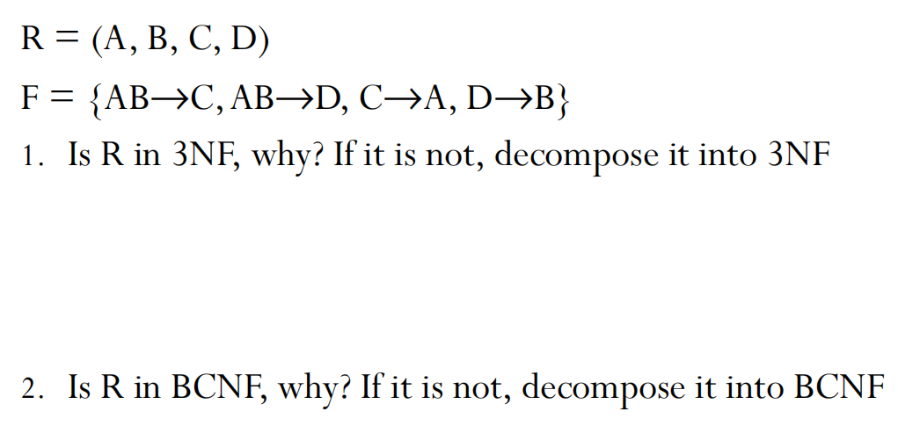
Exercise example

Slide 74
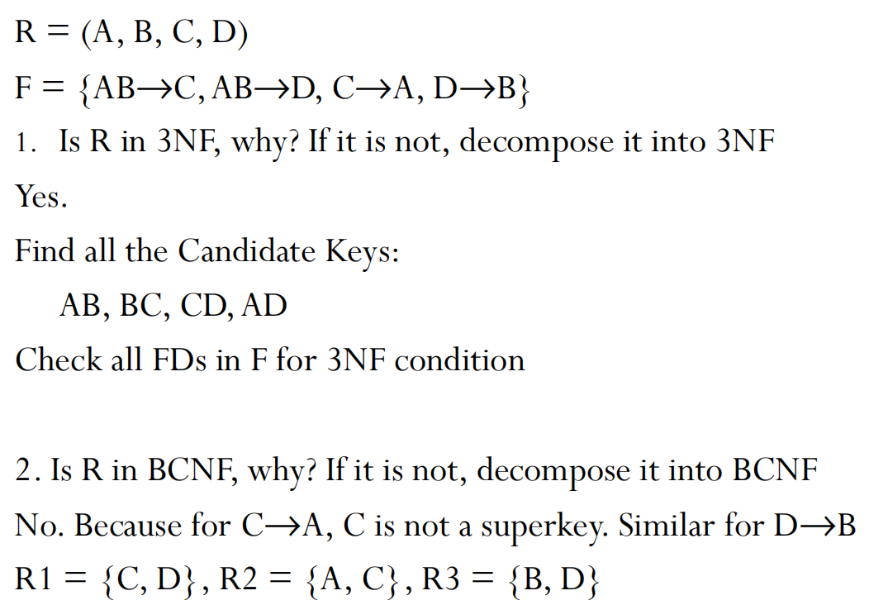
Exercise example
R is in 3NF if for any α → A in F
α → A is trivial (A ∈ α), or
α is a key for R, or
A is part of candidate key(s) for R

